Slide 1
WRITING
A FORMAL LETTER

Slide 2
Before you start writing, it's important to understand the purpose of the letter. Formal letters are written for official or professional purposes and should reflect a level of professionalism. It may be a formal application for a job, a letter of complaint, acceptance letter…

Slide 3
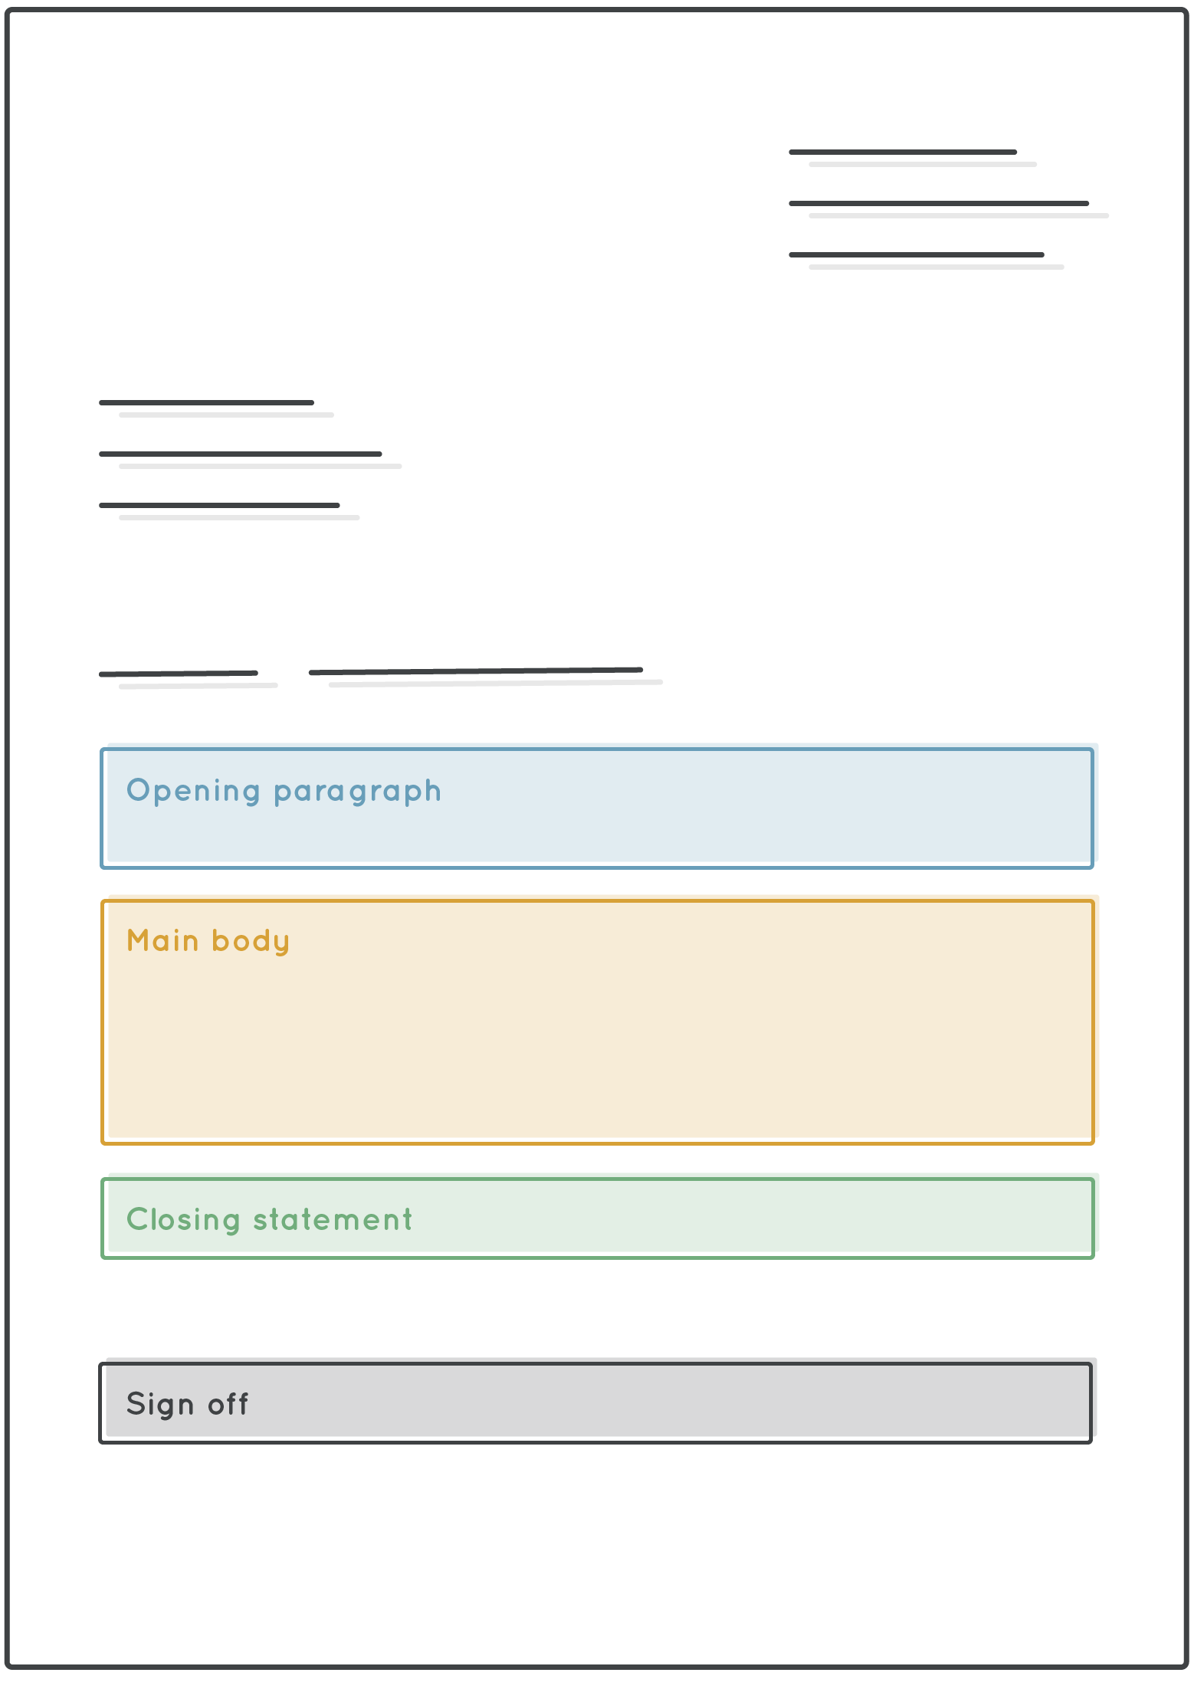
A formal letter should be written in a clear, concise and well-organized manner.
Use a business letter format, which includes your address, the date, the recipient's address, a salutation, opening paragraph, the body of the letter, a closing, and your signature.

Slide 4
Write your name, address and contact information (in the upper right-hand corner of the letter);
Then, write recipient's name and contact information, with their job title, name of their company and their address.
Ivan Horvat
manager
Kralja Tomislava 5
10000 Zagreb
ivanhorvat@email.com
093-555-555
26 February 2015
.
In this format, the recipient can easily find all of your contact information in case they need to get in touch with you for further information or clarification

Slide 5
Then, write the recipient’s name, job title, company name and contact information, including the address
Ms. Jane Smith
Manager
10 Oxford Street
London, UK
janesmith@email.com
In this format, the recipient's information is clearly and professionally presented, indicating that you have taken the time to research and address the letter to the correct person.

Slide 6
Begin your letter with a proper salutation, such as "Dear ___________,". If you don't know the recipient's name, you can use "To Whom it May Concern".
Example:
Dear Ms. Smith; Dear Jane Smith
Dear ‘Company name’ – Dear British Airways
Dear ‘Department’ - Dear Customer Services; Dear Human Resources Team

Slide 7
Write a clear and concise subject line: The subject line should give the recipient an idea of what the letter is about. It should be short, clear and to the point.
Subject: Request for meeting to discuss_____________
Subject: Customer support supervisor (application)

Slide 8
The body of the letter should include all relevant information, such as why you're writing, what you want to say, and any specific requests you may have. Make sure to use proper grammar and sentence structure, and avoid using slang or casual language. ( wanna, gonna, What’s up? Chill! Yo…)
End the letter with a professional closing, such as "Sincerely," or "Best Regards," followed by your name and signature.

Slide 9
Before you send the letter, make sure to double-check for spelling and grammar errors.
Keep in mind that there may be cultural differences in how formal letters are written in English-speaking countries
Finally, proofread your letter carefully to ensure that it is clear, concise, and free of errors.

Slide 10
Useful expressions that can be used in writing a formal letter:
Opening expressions
Expressions to introduce the purpose of the letter:
• Dear name of recipient,
• To Whom it may concern,
• Dear Sir/Madam,
• Dear position or title of recipient],

Slide 11
Expressions to make requests
Expressions to express gratitude
• Thank you for your attention to this matter.
• I appreciate your time and consideration.
• I am grateful for your help.

Slide 12
Closing expressions
Signature expressions
I look forward to hearing from you.
Please do not hesitate to contact me if you need further information/assistance...
I am available to discuss this matter further.
Please let me know how you would like to proceed.
I would appreciate your immediate attention to this matter
Yours sincerely,
Respectfully,
Kind regards (less formal but still professional)

Slide 13
In conclusion, when writing a business letter, it is important to keep in mind that the reader has limited time and wants you to get straight to the point. Here's what your letter should include:
1. Heading: This includes your address and the date.
2. Recipient's Address: Write the recipient's name, title, company, and address.
3. Salutation: Start with a formal greeting like "Dear" followed by the recipient's name.
4. Subject line (not essential)
5. Body of the letter: This is where you state the purpose of the letter and provide all the necessary details. Keep it short and to the point.
6. Closing: End the letter with a professional closing such as "Sincerely" followed by your signature and name

